Slide 1
Cogent Capstone Project
Ecommerce

Slide 2
Data Model
Entities
Account-related entities
Account
CustomUser
Product-related entities
Product
Category
Other entities
PurchaseOrder (FK)
SalesItem (FK)
Wishlist (FK)
Schema File
We used a schema file (based off of Hibernate generated schema) to load the database
Notes:
Chris

Slide 3
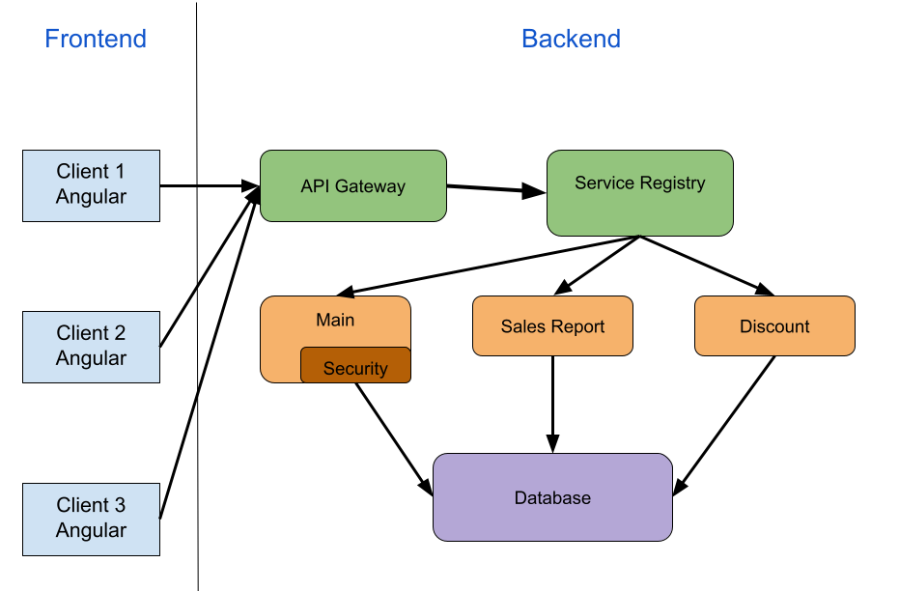
Notes:
Chris

Slide 4
Demo
URL: http://54.85.70.2/
Make sure that the database is cleaned and the database loader script is run

Slide 5
User Module
Guest (Not registered)
User (Registered)
All models related to products: (Model+Controller)
Products: [Shop, Product, Cart, Wishlist, Home] pages that display product(s).
Categories:
Categories are used by filters for product searching
All categories and related items can be seen on Home page
Product order/ cart: list of products that will be submitted in a transaction
Wishlist: list that users can use to save products without transaction

Slide 6
Home, About, Contact pages
Home - overview/summary
Functionalities
Features
About - introduction to management team
Certificates
Uniqueness
Reviews
Contact - submit form
Feedback
Report issues
Notes:
Mark

Slide 7
Security Module
Main service is authenticated using JWT tokens and Daoauthprovider
CustomUser Entity stores user details such as username, password, email, as well as tokens for resetting password
Every endpoint on Main service requires a valid jwt token or the request will be denied (except sign up, forget password, get all products/categories, and contact endpoints)
Token is generated first by checking if user details on login are correct and match up on the custom user entity using our configured authentication provider
Token maintains user authority, username, and expiration

Slide 8
Admin Module
CRUD operations on AccountController and ProductController
Used Apache POI for reading from an Excel file (we thought this was better than reading a csv file)... File image urls are given and these files already exist on storage. This is a suboptimal solution as it won't always work.
For adding products, when uploading an image, we generate a unique hash prefixed to the filename given, and store this image on the application server. Future versions could store the files on a separate file server.
SalesReport is a separate microservice (no security) that uses the same database
Angular Layout
We had services account-service, product-service, and sales-report-service for the three different main pages
When doing Product CRUD, everything was in one component.
When doing Account CRUD, we refined and had a top-level component and four components for the form and table views of Accounts and Discount. Used an event emitter to pass data from form to main component
Sales Report was similar to Account CRUD
Notes:
Chris

Slide 9
Challenges
Making the application more responsive – faster latency and throughput to backend application and database services
Scalability – using Docker Kubernetes to scale with more users and prevent downtime
Using a separate file server to store files
Integrating Security on all microservices
Routing through the Gateway for the main microservice

